Slide 1




Whats up with AI?

Slide 2
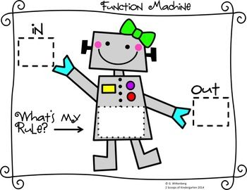
Functions
CS 106B
Lecture 1
Jan 4, 2015

Slide 3

Announcements
You can start Life now. Due Jan 15th
I would recommend getting QT creator installed on your computer.
Monday extra office hours with Megan! Gates 104 from
10am to 11am.
Chris office hours are moved to Friday 2:30pm to 3:30pm

Slide 4
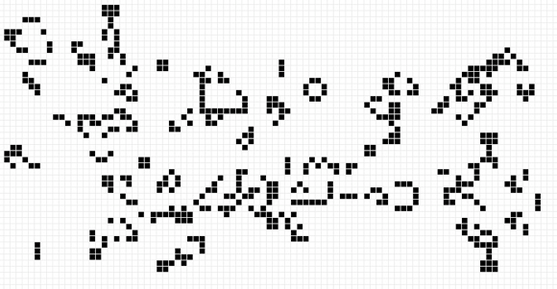
Life

Slide 5
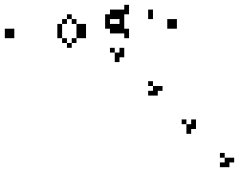
Life Simulated

Slide 6
Recap from Monday

Slide 7
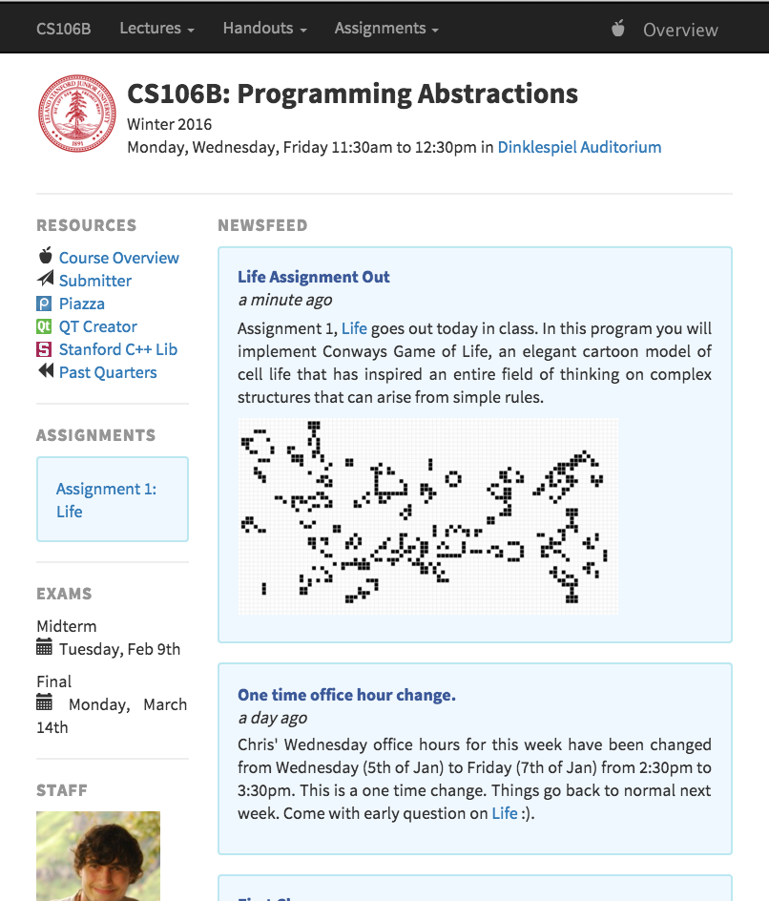
Class Website
cs106b.stanford.edu

Slide 8

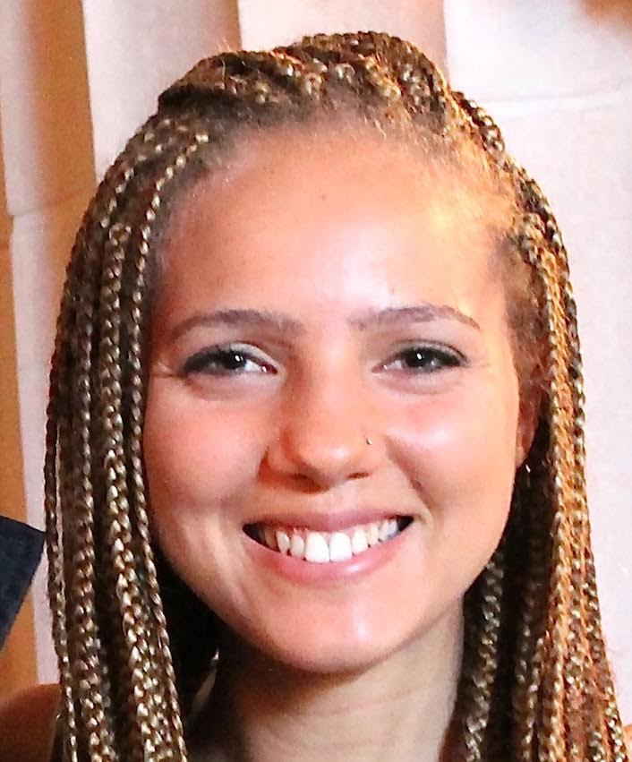
Course Staff
Instructor: Chris Piech
Office hours:
Mon 1:30 to 2:30pm
Wed 2:30 to 3:30pm
Head TA: Megan Faulk
Office hours:
Tue, Th 9:00 to 10:30am

Slide 9
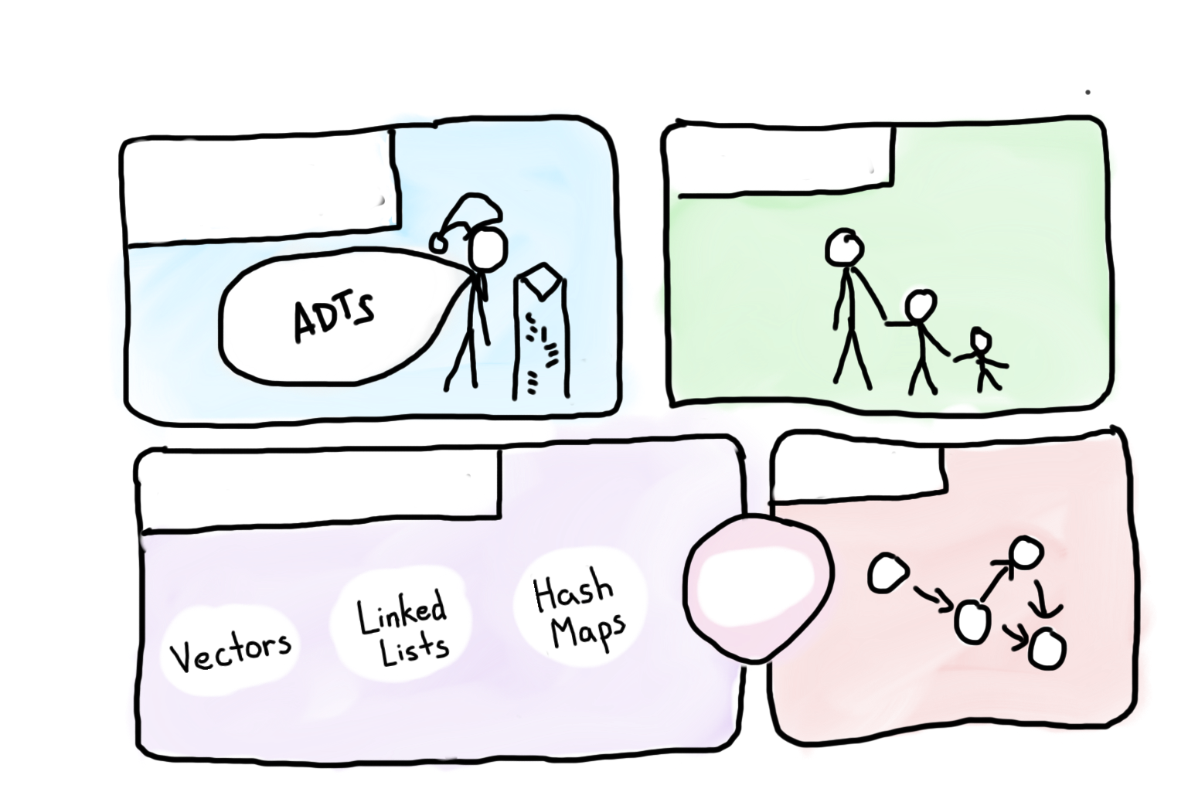
Course Syllabus
Intro to Abstractions
Recursion
Graphs
Under the Hood
Trees

Slide 10

Course Syllabus
Intro to Abstractions
Recursion
Graphs
Under the Hood
Trees
You are here

Slide 11

Today’s Goals
Intro to C++
Functions in C++

Slide 12
Part 1: C++

Slide 13

Similar to Java
C++ from the Java Programmer’s Perspective
(But it’s ok if you don’t know java!)

Slide 14
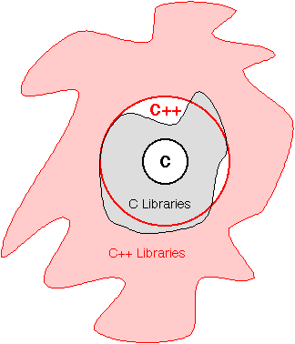
C++

Slide 15
Hello World
/*
* The canonical hello world program in C++
*/
#include <iostream> // A true classic.
#include "console.h" // A Stanford Library!
using namespace std; // The best namespace.
int main() {
cout << “hello, world!” << endl;
return 0;
}

Slide 16
Hello World
/*
* The canonical hello world program in C++
*/
#include <iostream> // A true classic.
#include "console.h" // A Stanford Library!
using namespace std; // The best namespace.
int main() {
cout << “hello, world!” << endl;
return 0;
}

Slide 17
Hello World
/*
* The canonical hello world program in C++
*/
#include <iostream> // A true classic.
#include "console.h" // A Stanford Library!
using namespace std; // The best namespace.
int main() {
cout << “hello, world!” << endl;
return 0;
}

Slide 18
Hello World
/*
* The canonical hello world program in C++
*/
#include <iostream> // A true classic.
#include "console.h" // A Stanford Library!
using namespace std; // The best namespace.
int main() {
cout << “hello, world!” << endl;
return 0;
}

Slide 19
Most Primitives are the Same
Java
C++
int
double
float
boolean
char
int
double
float
bool
char

Slide 20
Most Operators are the Same
Operator
Meaning
==
||
<=
=
Equals comparison
Logical or
Less than comparison
assignment

Slide 21
Most Control flow is the Same
Control
Meaning
while(cond) {
body
}
for(int i = 0; i < N; i++) {
body
}
if(cond) {
body A
} else {
body B
}
Repeat body until
cond is false.
Repeat body N times.
Either run bodyA or bodyB depending on cond.

Slide 22
Wahoo!

Slide 23
Is it all the same?

Slide 24
No.

Slide 25
Strings are a little different
#include <string>
...
string s = "hello";
A string is a (possibly empty) sequence of characters. Strings in C++ are conceptually similar to strings in Java.
Minor differences:
Different names for similar methods.
Different behavior for similar methods
Major differences
Strings are mutable (can be changed) in C++
There are two types of strings in C++

Slide 26
String Operators
Like in Java, you can concatenate strings using + or +=:
string s1 = "Chr";
s1 += "is"; // "Chris”
Unlike in Java, you can compare strings using relational operators:
string s2 = "Megan"; // == != < <= > >=
if (s2 > s1 && s2 != "Keith") { // true
...
}
Unlike in Java, strings are mutable and can be changed:
s1.append(" Piech") // s1 is ”Chris Piech"
s1.erase(3, 2); // s1 is ”Chr Piech"
s1[6] = 'o'; // s1 is “Chr Piech"

Slide 27
String Functions
Member function name | Description
s.append(str) | add text to the end of a string
s.compare(str) | return -1, 0, or 1 depending on relative ordering
s.erase(index, length) | delete text from a string starting at given index
s.find(str) s.rfind(str) | first or last index where the start of str appears in this string (returns string::npos if not found)
s.insert(index, str) | add text into a string at a given index
s.length() or s.size() | number of characters in this string
s.replace(index, len, str) | replaces len chars at given index with new text
s.substr(start, length) or s.substr(start) | the next length characters beginning at start (inclusive); if length omitted, grabs till end of string
string name = "Donald Knuth";
if (name.find("Knu") != 0) {
name.erase(7, 5); // "Donald"
}

Slide 28
Two Kinds of Strings
Strings
Any string literal such as "hi there" is a C string
string x = "text”;
C++ Strings
C-Strings

Slide 29
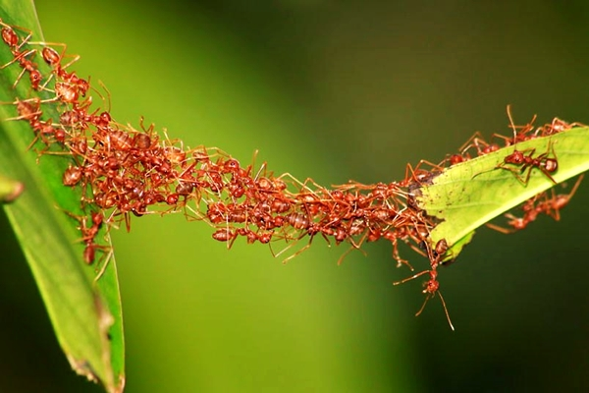
Aside: Common Bugs

Slide 30
C-String Bugs
string s = "hi" + "there”;
Does not compile; C strings can't be concatenated with +.
string s = string("hi") + "there";
string s = "hi"; // "hi" is auto-converted to string s += "there”;
These both compile and work properly.
int n = (int) "42”;
Bug; sets n to the memory address of the C string "42" (ack!).
int n = stringToInteger("42");
Works, because of explicit conversion.

Slide 31
Concatenation Bugs
string s = "hi" + '?'; // C-string + char
string s = "hi" + 41; // C-string + int
Bug; produces garbage, not "hi?" or "hi42". (memory address stuff)
string s = "hi"; // char '?' is concatenated to string s += '?'; // "hi?”
Works, because of auto-conversion.
s += 41; // "hi?)”
Adds character with ASCII value 41, ')', doesn't produce "hi?41".
s += integerToString(41); // "hi?41”
Works, because of conversion from int to string.

Slide 32
At this point seen some basics…

Slide 33

Ready to Dive In?

Slide 34
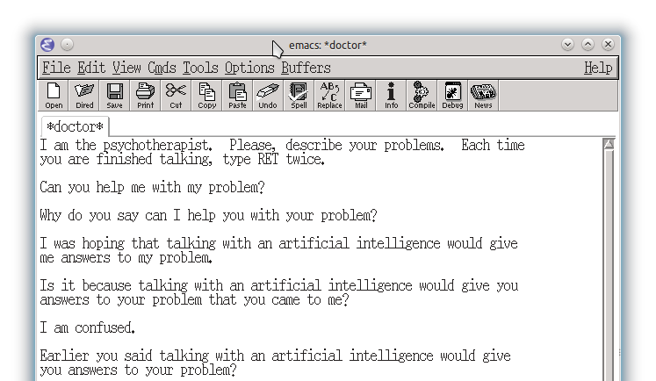
Doctor Eliza

Slide 35
Eliza Beta
Until the end of time:
Get a prompt from the user
If prompt is hello, respond
If prompt is a question ask why they asked
If prompt is a statement challenge its truth

Slide 36
Points

Slide 37
Points
Basics of C++ and Java are very similar. Slight difference in Strings.

Slide 38

Great start to C++

Slide 39
Part 2: Functions

Slide 40
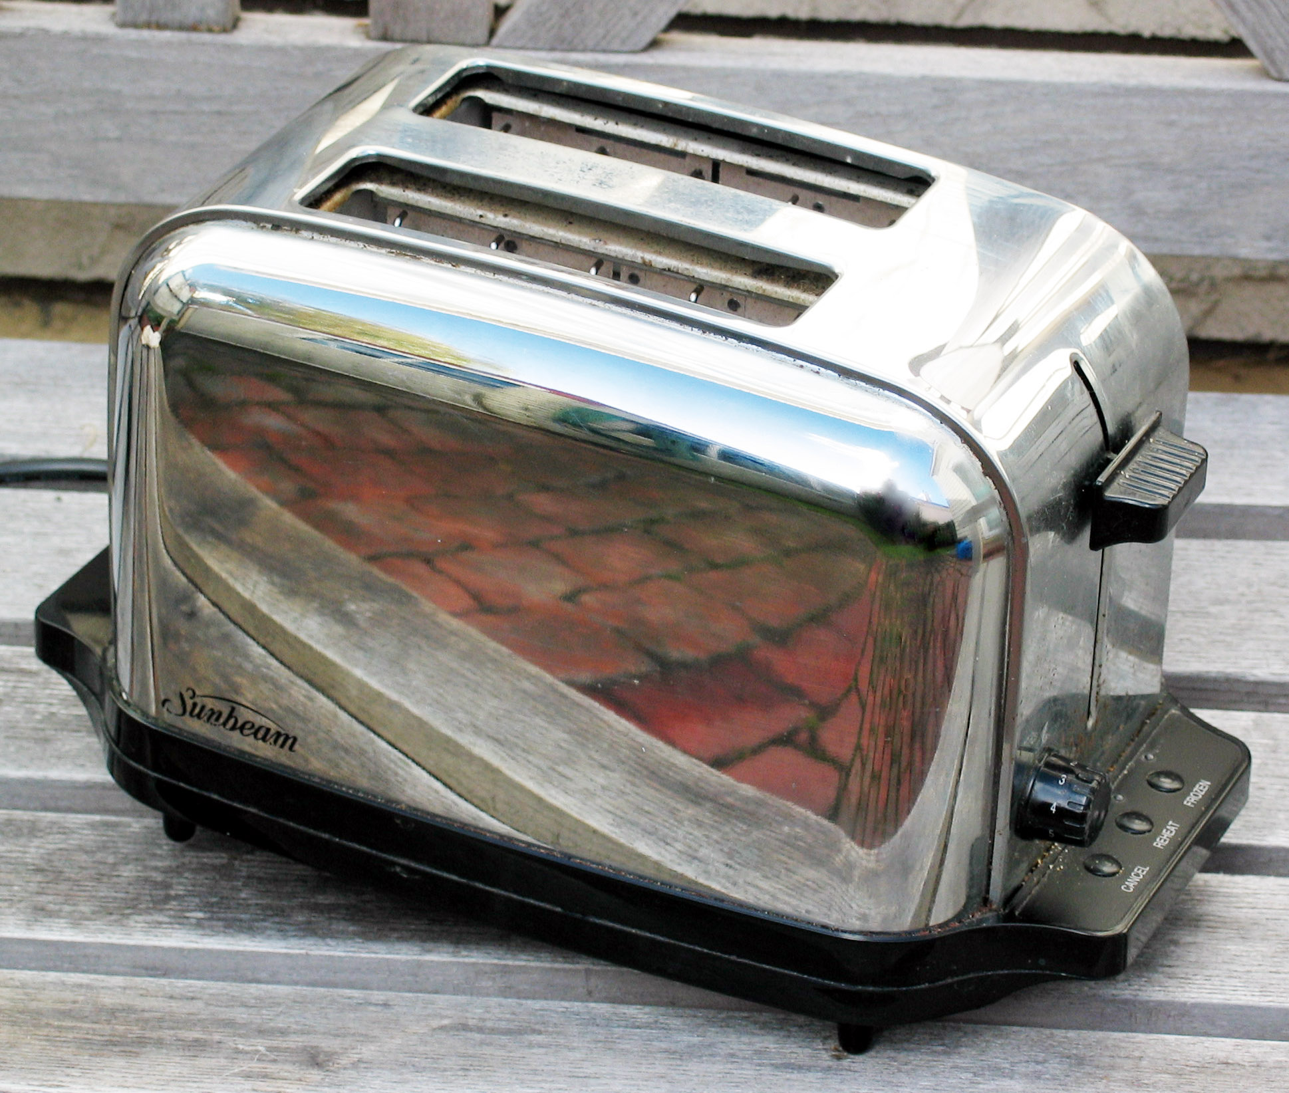
What is a Function?
You don’t know what automata is, do you? SOON!

Slide 41
A First C++ Function
#include <iostream>
#include "console.h"
using namespace std;
int main() {
cout << "|-5| = " << absoluteValue(-5) << endl;
return 0;
}
int absoluteValue(int n) {
if(n < 0) {
return -n;
}
return n;
}
You don’t know what automata is, do you? SOON!

Slide 42
A First C++ Function
#include <iostream>
#include "console.h"
using namespace std;
int main() {
cout << "|-5| = " << absoluteValue(-5) << endl;
return 0;
}
int absoluteValue(int n) {
if(n < 0) {
return -n;
}
return n;
}
Name
Parameters
Return
You don’t know what automata is, do you? SOON!
Body

Slide 43
A First C++ Function
#include <iostream>
#include "console.h"
using namespace std;
int main() {
cout << "|-5| = " << absoluteValue(-5) << endl;
return 0;
}
int absoluteValue(int n) {
if(n < 0) {
return -n;
}
return n;
}
You don’t know what automata is, do you? SOON!

Slide 44
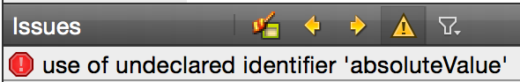

A First C++ Function (Error)
#include <iostream>
#include "console.h"
using namespace std;
int main() {
cout << "|-5| = " << absoluteValue(-5) << endl;
return 0;
}
int absoluteValue(int n) {
if(n < 0) {
return -n;
}
return n;
}
You don’t know what automata is, do you? SOON!

Slide 45

A First C++ Function (Fix 1)
#include <iostream>
#include "console.h"
using namespace std;
int absoluteValue(int n) {
if(n < 0) {
return -n;
}
return n;
}
int main() {
cout << "|-5| = " << absoluteValue(-5) << endl;
return 0;
}
You don’t know what automata is, do you? SOON!
Fix: Change order of functions

Slide 46
A First C++ Function (Fix 2)
#include <iostream>
#include "console.h"
using namespace std;
int absoluteValue(int n);
int main() {
cout << "|-5| = " << absoluteValue(-5) << endl;
return 0;
}
int absoluteValue(int n) {
if(n < 0) {
return -n;
}
return n;
}
Fix: Add a function “prototype”
You don’t know what automata is, do you? SOON!

Slide 47
Question: Why does C++ have the function prototype syntax?
C++ Design?
Why not just have a rule that you must set up the ordering so you define your functions before using them, as in the "FIX 1" example?
C++ could have done that, but such a rule would be too cumbersome for programmers to follow.
C++ could have done that, but good programming style dictates "top-down" approach that logically puts main() first and helper functions it calls to follow.
C++ could not have done that, because sometimes there is no way to order the functions so that all functions are defined before being used.
None of the above
You don’t know what automata is, do you? SOON!

Slide 48
Question: Why does C++ have the function prototype syntax?
C++ Design?
Why not just have a rule that you must set up the ordering so you define your functions before using them, as in the "FIX 1" example?
C++ could have done that, but such a rule would be too cumbersome for programmers to follow.
C++ could have done that, but good programming style dictates "top-down" approach that logically puts main() first and helper functions it calls to follow.
C++ could not have done that, because sometimes there is no way to order the functions so that all functions are defined before being used.
None of the above
Good logic
Good logic
You don’t know what automata is, do you? SOON!
Correct
No

Slide 49
Points
Basics of C++ and Java are very similar. Slight difference in Strings.

Slide 50
Points
Basics of C++ and Java are very similar. Slight difference in Strings.
Prototype your functions

Slide 51
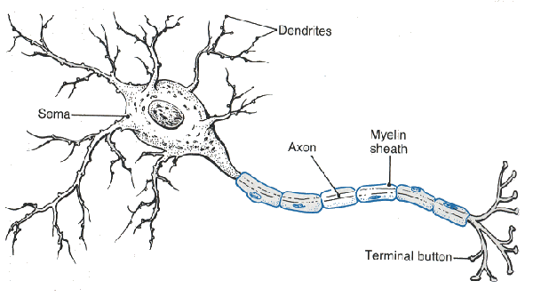
Lets Write a Function
You don’t know what automata is, do you? SOON!

Slide 52
Neuron

Slide 53
Neuron

Slide 54
Neuron

Slide 55
Neuron

Slide 56
Neuron

Slide 57
Some Inputs are More Important

Slide 58
Artificial Neuron
1
2
1
3
6
0.99
-2
0
1
1

Slide 59
Artificial Neuron
1
2
1
3
6
0.99
-2
0
1
1
InputSum = input1 * weight1 +
input2 * weight2 +
input3 * weight3 +
input4 * weight4

Slide 60
Artificial Neuron
1
2
1
3
6
0.99
-2
0
1
1
InputSum = 1 * 2 +
1 * 3 +
0 * -2 +
1 * 1

Slide 61
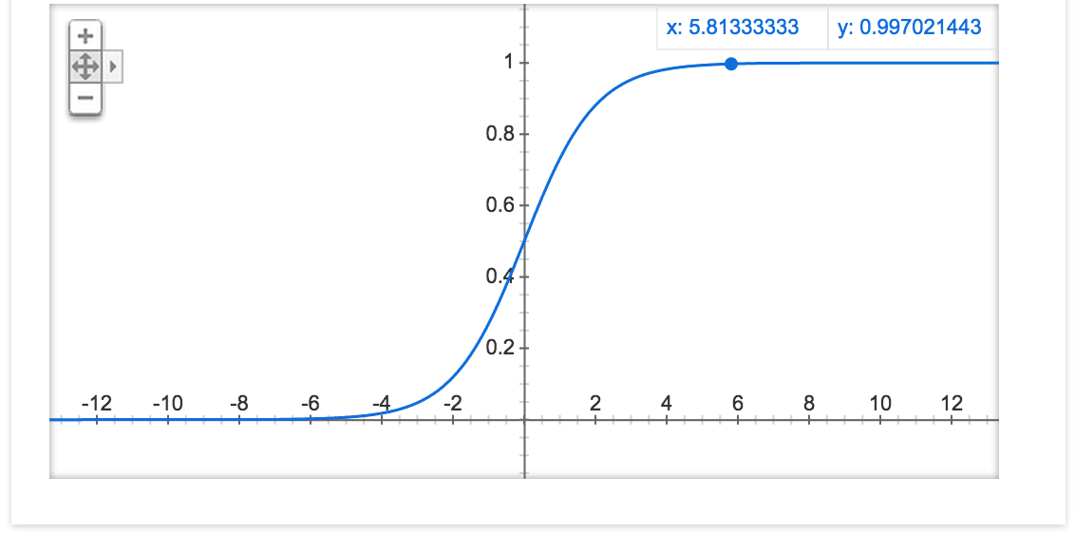
Sigmoid Function
1
2
1
3
6
0.99
-2
0
1
1

Slide 62
Artificial Neuron
1
2
1
3
6
0.99
-2
0
1
1
InputSum = input1 * weight1 +
input2 * weight2 +
input3 * weight3 +
input4 * weight4;
Output = sigmoid(InputSum);

Slide 63
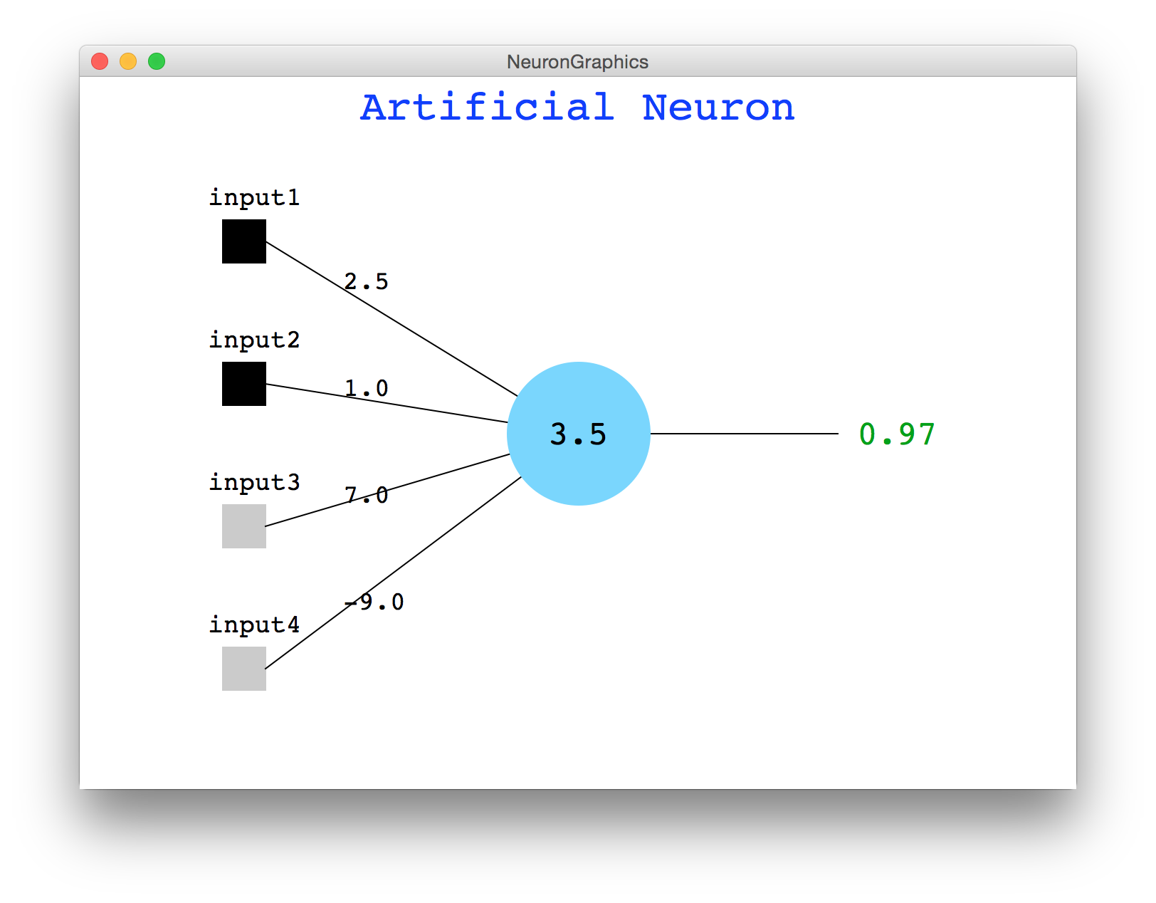
Artificial Neuron Demo

Slide 64
Let’s Write a Function
You don’t know what automata is, do you? SOON!

Slide 65
Lets Write a Function
1
2
1
3
6
0.99
-2
0
1
1
InputSum = input1 * weight1 +
input2 * weight2 +
input3 * weight3 +
input4 * weight4;
Output = sigmoid(InputSum);
You don’t know what automata is, do you? SOON!
double neuron(double x1, double x2);

Slide 66
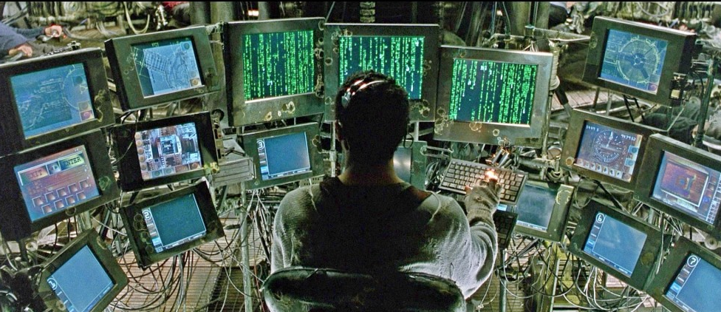

Slide 67
Pass by Value
Value semantics: In Java and C++, when variables (int, double) are passed as parameters, their values are copied.
Modifying the parameter will not affect the variable passed in.
void grow(int age) {
age = age + 1;
cout << "grow age is " << age << endl;
}
int main() {
int age = 20;
cout << "main age is " << age << endl;
grow(age);
cout << "main age is " << age << endl;
return 0;
}
Output:
main age is 20
grow age is 21
main age is 20

Slide 68
Pass by Reference (2.5)
Reference semantics: In C++, if you declare a parameter with an & after its type, instead of passing a copy of its value, it will link the caller and callee functions to the same variable in memory.
Modifying the parameter will affect the variable passed in.
void grow(int& age) {
age = age + 1;
cout << "grow age is " << age << endl;
}
int main() {
int age = 20;
cout << "main age is " << age << endl;
grow(age);
cout << "main age is " << age << endl;
return 0;
}
Output:
main age is 20
grow age is 21
main age is 21

Slide 69

Pass by Reference Example
With reference parameters, you can write a swap function.
/*
* Places a's value into b and vice versa.
*/
void swap(int& a, int& b) {
int temp = a;
a = b;
b = temp;
}

Slide 70
A Mystery
What is the output of this code?
void mystery(int& b, int c, int& a) {
b--;
a++; // A. 5 3 13
c += a; // B. 5 2 8
} // C. 4 3 7
// D. 4 2 9
int main() { // E. other
int a = 5;
int b = 2;
int c = 8;
mystery(a, b, c);
cout << a << " " << b << " " << c << endl;
return 0;
}
Notes:
Correct answer: B. 5 3 7

Slide 71
A Mystery
What is the output of this code?
void mystery(int& b, int c, int& a) {
b--;
a++;
c += a;
}
int main() {
int a = 5;
int b = 2;
int c = 8;
mystery(a, b, c);
cout << a << " " << b << " " << c << endl;
return 0;
}
Notes:
Correct answer: B. 5 3 7

Slide 72
A Mystery
What is the output of this code?
void mystery(int& b, int c, int& a) {
b--;
a++;
c += a;
}
int main() {
int a = 5;
int b = 2;
int c = 8;
mystery(a, b, c);
cout << a << " " << b << " " << c << endl;
return 0;
}
Notes:
Correct answer: B. 5 3 7

Slide 73
A Mystery
What is the output of this code?
void mystery(int& b, int c, int& a) {
b--;
a++;
c += a;
}
int main() {
int a = 5;
int b = 2;
int c = 8;
mystery(a, b, c);
cout << a << " " << b << " " << c << endl;
return 0;
}
b = 5
c = 2
a = 8
Notes:
Correct answer: B. 5 3 7

Slide 74
A Mystery
What is the output of this code?
void mystery(int& b, int c, int& a) {
b--;
a++;
c += a;
}
int main() {
int a = 5;
int b = 2;
int c = 8;
mystery(a, b, c);
cout << a << " " << b << " " << c << endl;
return 0;
}
b = 5
c = 2
a = 8
Now b = 4
Notes:
Correct answer: B. 5 3 7

Slide 75
A Mystery
What is the output of this code?
void mystery(int& b, int c, int& a) {
b--;
a++;
c += a;
}
int main() {
int a = 5;
int b = 2;
int c = 8;
mystery(a, b, c);
cout << a << " " << b << " " << c << endl;
return 0;
}
b = 5
c = 2
a = 8
Now b = 4
Now a = 9
Notes:
Correct answer: B. 5 3 7

Slide 76
A Mystery
What is the output of this code?
void mystery(int& b, int c, int& a) {
b--;
a++;
c += a;
}
int main() {
int a = 5;
int b = 2;
int c = 8;
mystery(a, b, c);
cout << a << " " << b << " " << c << endl;
return 0;
}
b = 5
c = 2
a = 8
Now b = 4
Now a = 9
Now c = 11
Notes:
Correct answer: B. 5 3 7

Slide 77
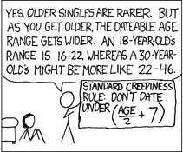
Output Parameters
What is the minimum and maximum non-creepy age to date?
http://xkcd.com/314/

Slide 78
Output Parameters
void datingRange(int age, int& min, int& max);
int main() {
int young;
int old;
datingRange(48, young, old);
cout << "A 48-year-old could date someone from "
<< young
<< " to "
<< old
<< " years old."
<< endl;
return 0;
}
void datingRange(int age, int& min, int& max) {
min = age / 2 + 7;
max = (age - 7) * 2;
}
// A 48-year-old could date someone from
// 31 to 82 years old.

Slide 79
Pass by Reference Pros / Cons
Benefits of reference parameters:
a useful way to be able to 'return' more than one value
often used with objects, to avoid making bulky copies when passing
Downsides of reference parameters:
hard to tell from call whether it is ref; can't tell if it will be changed
foo(a, b, c); // will foo change a, b, or c? :-/
(very) slightly slower than value parameters
can't pass a literal value to a ref parameter
grow(39); // error

Slide 80

Insight into Java
In Java, primitives are passed by value, and objects are passed by reference

Slide 81
Points
Basics of C++ and Java are very similar. Slight difference in Strings.
Prototype your functions

Slide 82
Points
Basics of C++ and Java are very similar. Slight difference in Strings.
Prototype your functions
Pass by reference vs
pass by value

Slide 83
Today’s Goals
Intro to C++
Functions in C++

Slide 84
Story of Modern AI

Slide 85
Whats up with AI?

Slide 86
Remember Me?

Slide 87
Put Many Together

Slide 88
Put Many Together

Slide 89
Put Many Together

Slide 90
Put Many Together

Slide 91
Put Many Together

Slide 92

Google Brain
1 Trillion Artificial Neurons

Slide 93
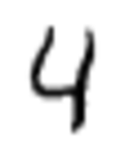
Make It Useful

Slide 94
Make It Useful

Slide 95
Make It Useful
This means it’s a picture of the number 4

Slide 96
Big Milestones

Slide 97

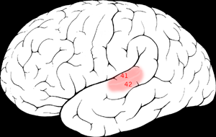

One Learning Algorithm
One Algorithm Hypothesis
Auditory Cortex
Auditory cortex learns to see
[Roe et al., 1992]
[Andrew Ng]

Slide 98
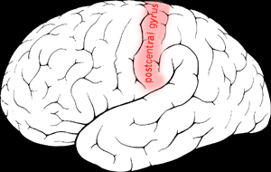

One Algorithm Hypothesis
Somatosensory Cortex
Somatosensory cortex learns to see
[Metin & Frost, 1989]
[Andrew Ng]

Slide 99
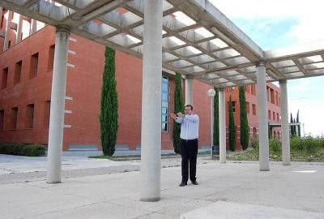
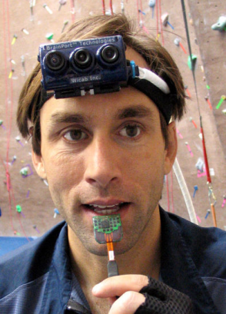

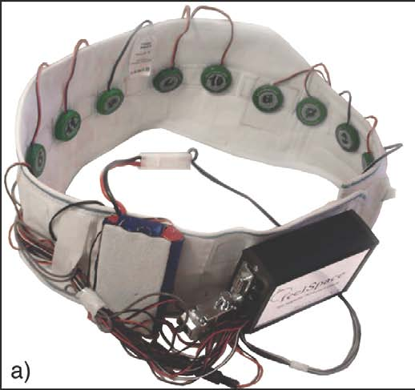

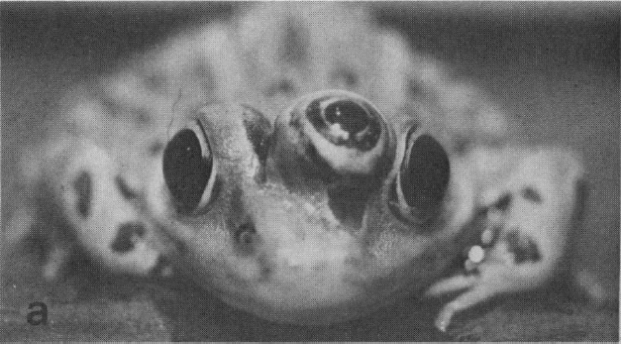
Sensor Representations
Seeing with your tongue
Human echolocation (sonar)
Haptic belt: Direction sense
Implanting a 3rd eye
[BrainPort; Welsh & Blasch, 1997; Nagel et al., 2005; Constantine-Paton & Law, 2009]

Slide 100

Know It So You Can Beat It
Little math

Slide 101
The End.

Slide 102
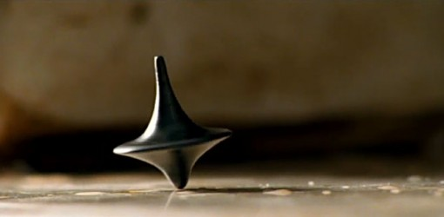
The End?

